Slide 1
Female Reproductive System
Part 2
Dr. Fatin latef

Slide 2
Corpus Leteum
After ovulation, the granulosa cells and the cells of the theca interna of the ovulated follicle reorganize to form a temporary endocrine gland called the corpus luteum, which becomes embedded within the cortical region, burst follicles wall collapses , becoming folded.
Lining granulosa cells become secretary granulosa lutein cell-the main component of the corpus luteum of menstruation (CLM), or of pregnancy (CLP);theca interna cells become secretary theca lutein cells.
Its formation is stimulated by (LH), the life span of corpus luteum is finite lasting about 12 days during the average cycle.
Secret estrogen and progesterone, makes the uterine mucosa secretory; and inhibits menstruation and uterine muscle contraction, if implantation occurs.

Slide 3
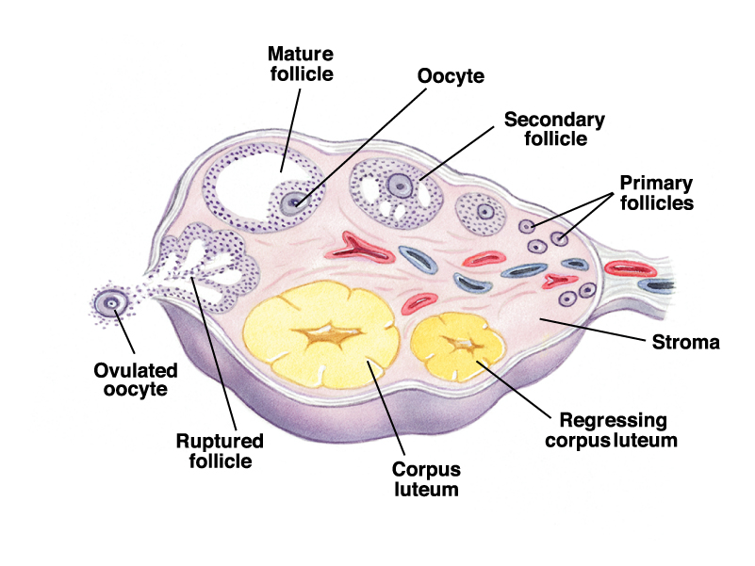
Late in pregnancy, or late in the menstrual cycle (if the shed oocyte Is not fertilized), the glandular lutein cells degenerate; the corpus luteum shrinks, and is replaced by a small pale mass of hyalinized CT- corpus albicans.
If pregnancy occurs, placental hormones maintain the corpus luteum, and it is known as the corpus luteum of pregnancy, this structure is functional for the first trimester of pregnancy.

Slide 4
Uterine tube (oviducts)
Are paired ducts that catch the ovulated secondary oocyte, nourish both the oocyte and sperm, provide the microenvironment for fertilization, it has two ends, ovarian end and uterine end, and at this region the oviduct become narrow called Isthmus.
The oviducts are divided in to four anatomical regions:
_Infundibulum: the open end is finger like projection called Fimbria, facing the ovulated site during ovulation.
_Ampulla : location of fertilization.
_Isthmus : the narrow portion between the ampulla and uterus.
_Intramural region : pass through the uterine wall to open in to the lumen of the uterus.

Slide 5
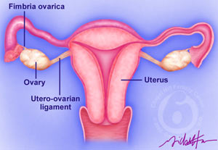

Slide 6
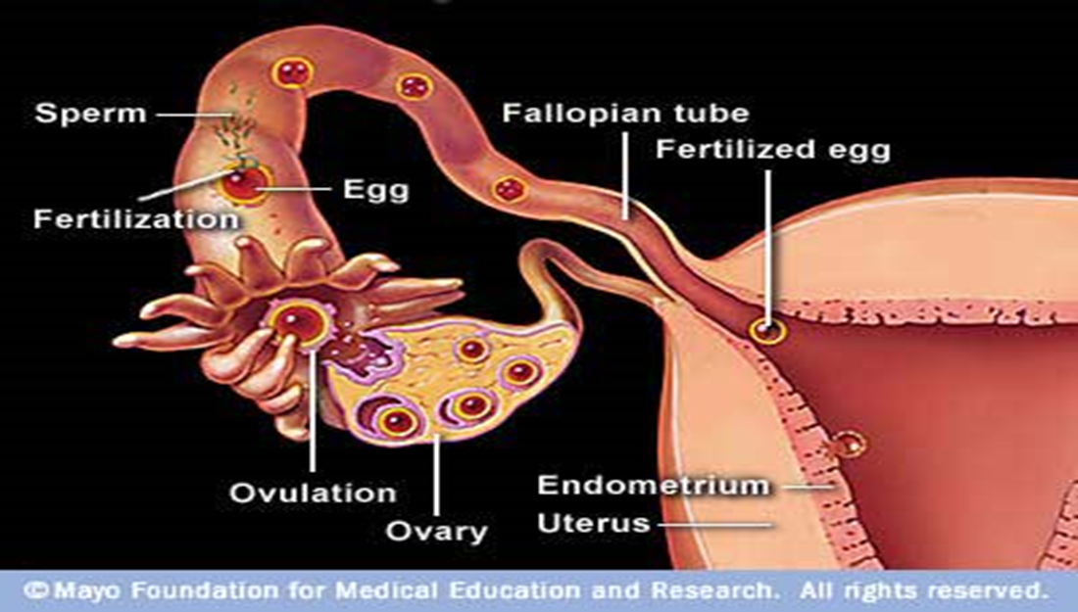

Slide 7
Their walls of oviducts composed of :
The wall of oviduct consist of a folded mucosa, has numerous branching, longitudinal folds that are most prominent in the ampulla, these mucosal folds become smaller in the segment of the tube closer to the uterus.
The epithelium (simple columnar epithelium) contains two interspersed, functionally important cell types:
Ciliated cells and darker staining secretory cells, or peg cells, whose apical ends typically bulge into the lumen which produce glycoprotein's and nutritive and lubricating fluid covering the epithelium, the cilia beat toward the uterus, causing movement of the viscous liquid that covers the epithelial surface.

Slide 8
A thick muscular is with somewhat interwoven circular (or spiral) and longitudinal layers of smooth muscle, this
layer contracts to move the embryo toward the uterus and its mucosa facilitate sperm and oocyte movement, and provides a nutritive and protective environment for fertilization and early embryonic development.
The serosa composed of simple squamous epithelium, the loose c.t between the serosa and the muscular is contains many blood vessels and nerve fibers.

Slide 9
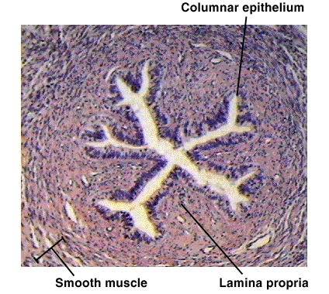

Slide 10
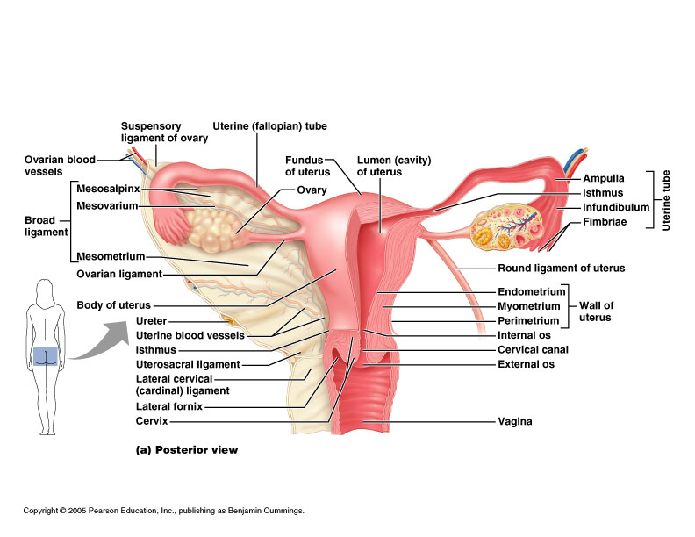
The uterus:
Pear shaped structure attached to oviducts at upper end and to vagina at lower end.
Uterine wall has 3 layers:
Endometrium
Myometrium
Serosa or
adventitia

Slide 11
Endometrium
composed of simple columnar epithelium invaginated in to simple tubular glands, ciliated columnar cells and secretory columnar cells.
lamina propria composed of highly cellular connective tissue and vessels.
two zones in Endometrium:
Functional layer
a thick superficial layer that is sloughed off during menstruation.
Replaced during each menstrual cycle.
Is vascular zed by numerous coiled arteries.

Slide 12
Basal layer
A deeper layer, narrow whose glands and connective tissue elements retained after menstruation.
Gland cells give rise to new epithelium.
Myometrium
Thickest muscular layer wall of the uterus.
Composed of three layers of smooth muscle separated by connective tissue.
Inner and outer layers are mostly longitudinal in orientation.
Middle layers are more circular, thickens in pregnancy with more smooth muscle cells and increased collagen.
The size and number of the myometrial muscle cell related to estrogen level.

Slide 13
Serosa or Adventitia
Much of its anterior portion is covered by adventitia consist of connective tissue without an epithelial covering.
The fundus and posterior portion of the body are covered by a serosa, composed of a layer of squamous mesothelium cells resting on areolar connective tissue.

Slide 14
Uterine cervix
Lower part of uterus.
Lined by mucous secretion simple columnar epithelium.
Some smooth muscle and much connective tissue in lamina propria.
Part of cervix in upper vagina has stratified squamous no keratinized epithelium.
Cervical mucosa has mucous glands.
Less branching no coiled artery, thicker Endometrium and thinner Myometrium.
Cervical mucosa remains intact during menstrual cycle.
Cervical gland secretions vary during menstrual cycle.
At ovulation mucous is watery so sperm can penetrate easily, in luteal phase or pregnancy mucous more viscous to block sperm or microbes.

